Slide 1
HTTP 2: methods and Response Codes
Andrew Beatty
Andrew.Beatty@gmit.ie
Data Represtentation

Slide 2
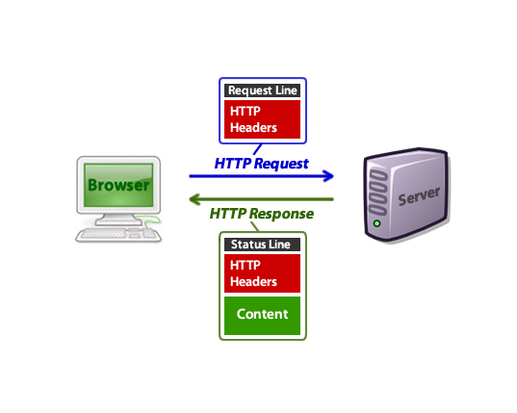
From: https://code.tutsplus.com/tutorials/http-headers-for-dummies--net-8039

Slide 3
Request
GET /course/view.php?id=1318 HTTPS/1.1
User-Agent: Mozilla/4.0 (compatible; MSIE5.01; Windows NT)
Host: learnonline.gmit.ie
Accept-Language: en-us
Accept-Encoding: gzip, deflate
Connection: Keep-Alive
This week I want to look at methods
POST /cgi-bin/process.cgi HTTP/1.1
User-Agent: Mozilla/4.0 (compatible; MSIE5.01; Windows NT)
Host: www.tutorialspoint.com
Content-Type: application/x-www-form-urlencoded
Content-Length: length
Accept-Language: en-us
Accept-Encoding: gzip, deflate
Connection: Keep-Alive
licenseID=string&content=string&/paramsXML=string

Slide 4
Methods
Method | Description | In RESTful API
GET | Retrieves a Resource(s) | Read
POST | Updates/creates/changes a Resource | Create
PUT | Used more to update a Resourse | Update
DELETE | Remove a resourse | Delete
HEAD | Retrieves header info
TRACE | Used for Debugging
OPTIONS | Retrieve allowable options
PATCH | Partial resource modification
CONNECT | Set up a tunnel for other traffic to pass through HTTP

Slide 5
HTTP Methods Get Vs Post
 | GET | POST
Security | Parameters are visible to the user and browser History. Never use GET when sending passwords or other sensitive information! | POST is a little safer than GET because the parameters are not stored in browser history or in web server logs
Back Button | harmless | Data will be resubmitted
Bookmarked | Can be bookmarked | Parameters are not bookmarked
Cached | Can be cached | Not cached
Encoding type | application/x-www-form-urlencoded | application/x-www-form-urlencoded or multipart/form-data. Use multipart encoding for binary data
History | Parameters remain in browser history | Parameters are not saved in browser history
Visibility | Data is visible to everyone in the URL | Data is not displayed in the URL

Slide 6
HTTP Methods Get Vs Post
 | GET | POST
Restrictions on data length | data length Yes, when sending data, the GET method adds the data to the URL; and the length of a URL is limited (maximum URL length is 2048 characters) | No Restrictions
Restrictions on data type | Only ASCII characters allowed | No restrictions. Binary data is also allowed

Slide 7
HTTP Response
Requests and responses both have this format: • Intial line.
• Zero or more header lines.
• A blank line.
• Optional message body (e.g. a HTML ﬁle)
HTTP/1.1 200 OK
Date: Mon, 27 Jul 2009 12:28:53 GMT
Server: Apache/2.2.14 (Win32)
Last-Modified: Wed, 22 Jul 2009 19:15:56 GMT
Content-Length: 88
Content-Type: text/html
Connection: Closed
<html>
<body>
<h1>Hello, World!</h1>
</body>
</html>

Slide 8
Status codes
Code Range | Status
100 – 199 | Informational
200 – 299 | Successful
300 – 399 | Redirection
400 – 499 | Client Error
500 – 599 | Server Error

Slide 9
Status codes
Code | text | description
200 | OK | Successful
201 | Created | Resource created
204 | No Content | The requested resource is empty
400 | Bad Request | Bad Syntax
401 | Unauthorised | Client might need to be authenticated
403 | Forbidden | Operation not allowed
404 | Not Found | Resource does not exists
500 | Internal Server Error | Something went wrong during processing
More at
https://www.restapitutorial.com/httpstatuscodes.html

Slide 10
Summary
HTTP request have methods
HTTP responses have status codes
(These are used in restful APIs)

